Slide 1
Improving Care
by
Improving Teams:
Design and Implementation of FIRMs
(Fully Integrated Regionalized Microteams)
Presented by:
Ali Wang, Management Engineer
Julius Yang, MD, PhD Medical Director of Health Care Quality
Sandra Sanchez, RN, MSN, Nursing Director

Slide 2
Presentation Outline
Background
  Design thinking
Structural Intervention:
  FIRM (Fully Integrated Regionalized Micro-teams)
Functional intervention:
  Interdisciplinary team huddle
Outcomes
Teamwork improvement model:
  Relational coordination
Lesson’s Learned

Slide 3
Session Learning Objective
Participants should be able to understand principles from our change model to improve structural and functional alignment of physician-nursing workflow in order to improve the overall patient and clinician experience

Slide 4
Our Challenge
In the setting of rising acuity and complexity
Can we provide care for every patient that is
  Safer
  More effective
  More patient-centered
  With shorter lengths of stay
  Without adding resources
  While reducing provider burnout?

Slide 5
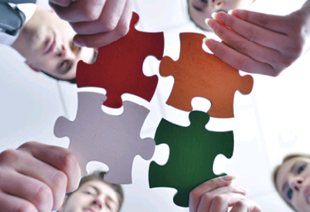
Our Untapped Potential:
Advanced Teamwork

Slide 6
Presentation Outline
Background
  Design thinking
Structural Intervention:
  FIRM (Fully Integrated Regionalized Micro-teams)
Functional intervention:
  Interdisciplinary team huddle
Outcomes
Teamwork improvement model:
  Relational coordination
Lessons Learned

Slide 7

Design Thinking:
Doctors, Nurses, and Patients
EMPATHIZE
IDEATE
DEFINE
PROTOTYPE
IMPLEMENT
TEST
Adapted from: IDEO

Slide 8
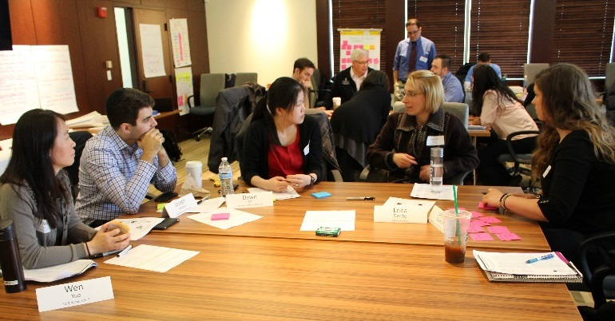
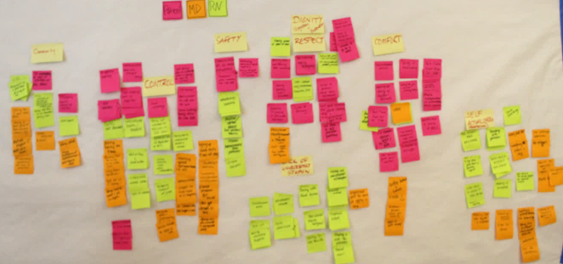
Design Thinking:
Doctors, Nurses, and Patients
Core Needs (themes):
Safety
Comfort
Control
Respect/Dignity
“Flow”/lack of strain
Efficacy
Community
Interviewing to empathize:
What does a good day look like?
What does a bad day look like?

Slide 9
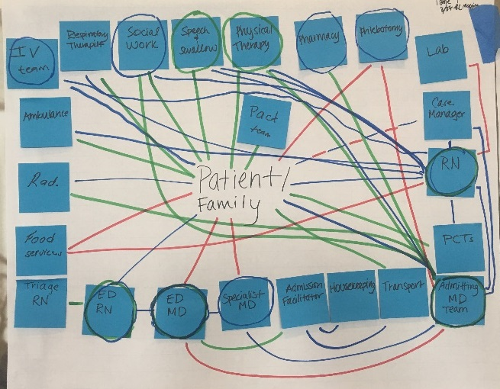
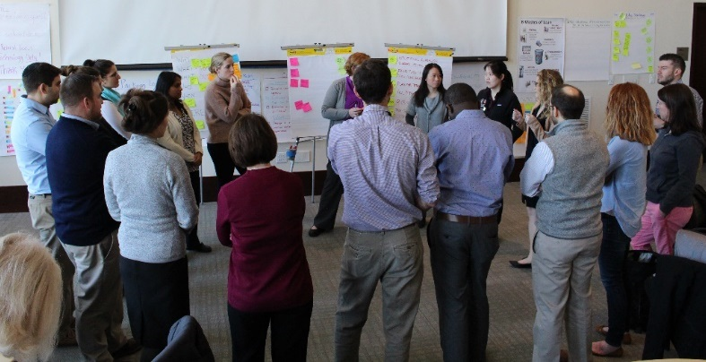
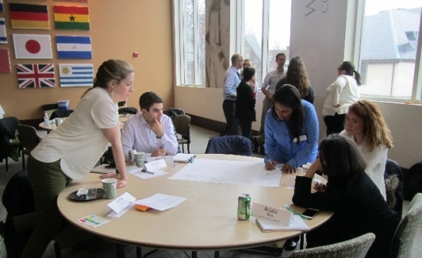
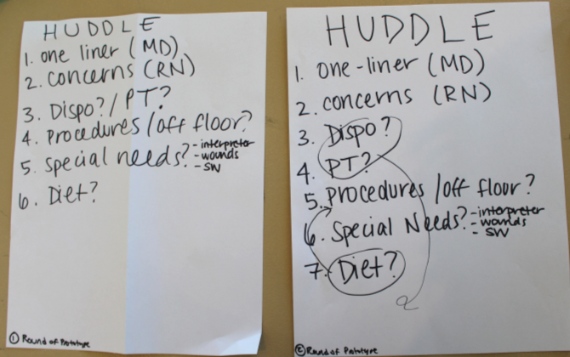
Design Thinking:
Doctors, Nurses, and Patients

Slide 10

Patient Perspective
Lack of sense that doctors and nurses are working together in cohesive manner
Mixed/conflicting messages
Delayed responses to issues/concerns
Inefficient delivery of care
Safety/efficacy?
We need to build better teams!

Slide 11
Presentation Outline
Background
  Design thinking
Structural Intervention:
  FIRM (Fully Integrated Regionalized Micro-teams)
Functional intervention:
  Interdisciplinary team huddle
Outcomes
Teamwork improvement model:
  Relational coordination
Lessons Learned

Slide 12



Our “Old” Model:
Ward-based “Macroteams”

Slide 14
Macroteam: MD-RN Affiliations
Barriers to team structure
MD Team -> | Blue | Red | Green | Purple | # of MD Teams per RN
Nurse 1 | 1 | 1 |  | 2 | 3
Nurse 2 | 1 | 1 | 1 | 1 | 4
Nurse 3 |  | 3 | 1 |  | 2
Nurse 4 | 1 | 2 |  | 1 | 3
Nurse 5 |  | 1 | 1 | 2 | 3
Nurse 6 |  | 1 | 1 | 2 | 3
Nurse 7 | 1 |  | 2 | 1 | 3
Nurse 8 | 1 | 2 |  | 1 | 3
Nurse 9 | 1 | 1 | 1 | 1 | 4
MD Team total | 6 | 12 | 7 | 11

Slide 15
Stages of Teamwork
Synchronized
Coordinated
Collaborative
Collegial

Slide 16
Stages of Teamwork
Synchronized
Coordinated
Collaborative
Collegial

Slide 17
A new FIRM model
Fully Integrated Regionalized Microteams
  Full = Doctors AND Nurses
  Integrated = Assigned to same patients
  Regionalized = Floor/Pod-based structure
  Microteams = Team structures/processes to ensure patient-centered

Slide 18
Our “New” Model:
Pod-based “Microteams”

Slide 19
Microteam: MD-RN Affiliations
Creating practical team structure
MD Team | Blue Day | Red Day | Green Day | Evening | # of MD Teams per RN
Nurse 1 | 4 |  |  |  | 1
Nurse 2 | 4 |  |  |  | 1
Nurse 3 | 4 |  |  |  | 1
Nurse 4 |  | 4 |  |  | 1
Nurse 5 |  | 4 |  |  | 1
Nurse 6 |  | 4 |  |  | 1
Nurse 7 |  |  | 4 |  | 1
Nurse 8 |  |  | 4 |  | 1
Nurse 9 |  |  | 4 |  | 1
MD Team total | 12 | 12 | 12

Slide 20
Stages of Teamwork
Synchronized
Coordinated
Collaborative
Collegial

Slide 23
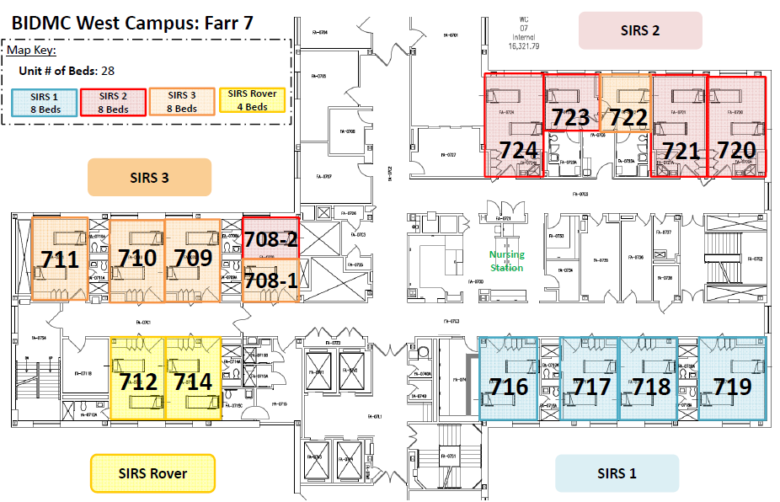
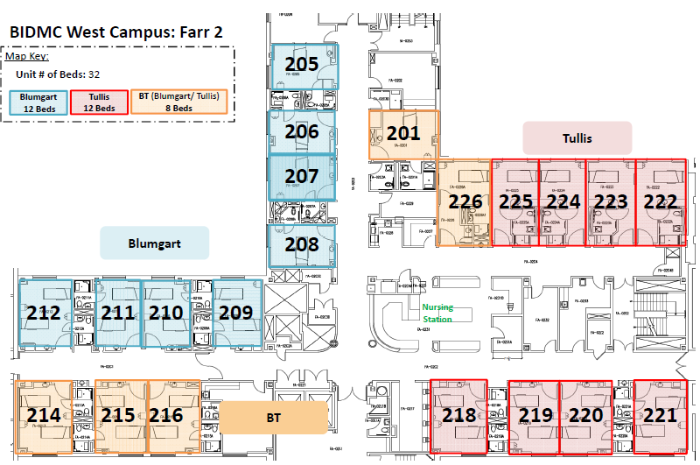
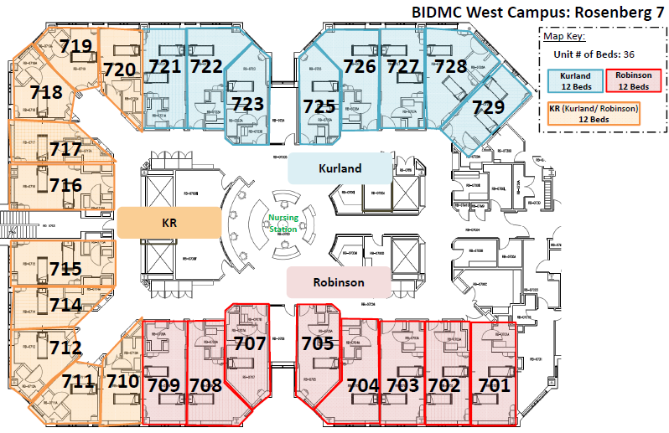
A new FIRM model
July 2017
Implemented simultaneously on 3 general medicine units
Hospitalist/housestaff physician teams
Approximately 20% of daily inpatient census

Slide 24
Presentation Outline
Background
  Design thinking
Structural Intervention:
  FIRM (Fully Integrated Regionalized Micro-teams)
Functional intervention:
  Interdisciplinary team huddle
Outcomes
Teamwork improvement model:
  Relational coordination
Lesson’s Learned

Slide 25
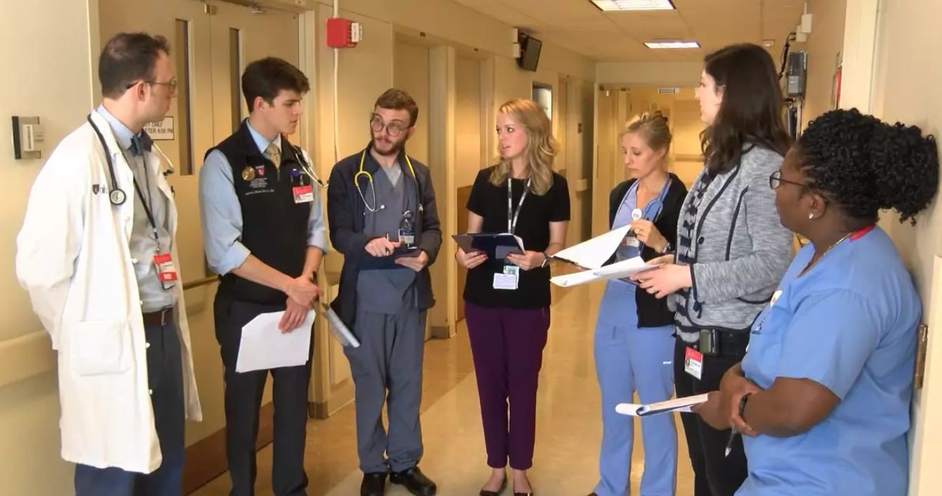
Functional intervention:
Interdisciplinary team huddle
Morning Awareness and Planning (MAP) Huddle

Slide 26
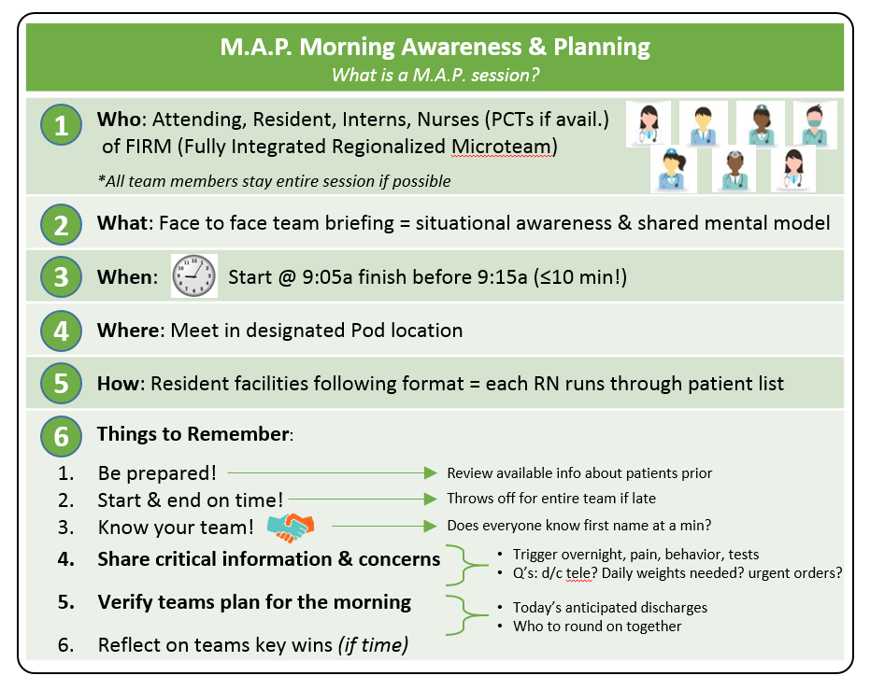
Morning Awareness & Planning (M.A.P.) Huddle

Slide 27
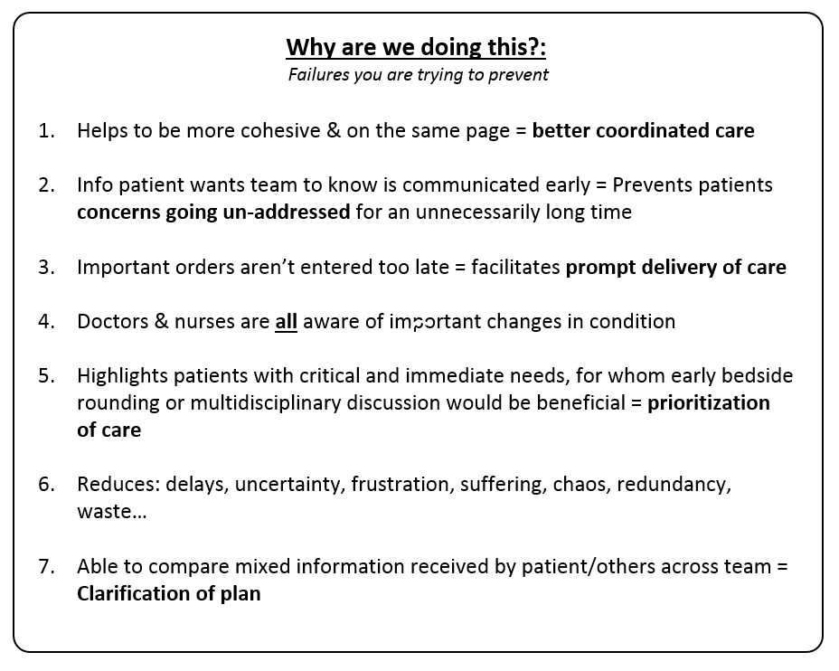
Morning Awareness & Planning (M.A.P.) Huddle

Slide 28
Stages of Teamwork
Synchronized
Coordinated
Collaborative
Collegial

Slide 29
Presentation Outline
Background
  Design thinking
Structural Intervention:
  FIRM (Fully Integrated Regionalized Micro-teams)
Functional intervention:
  Interdisciplinary team huddle
Outcomes
Teamwork improvement model:
  Relational coordination
Lessons Learned

Slide 30

Steps on a Journey
Do
Study
Act
Plan
FIRM
Model
Do
Study
Act
Plan
Relational
Coordination
Improved Teamwork Outcomes

Slide 31
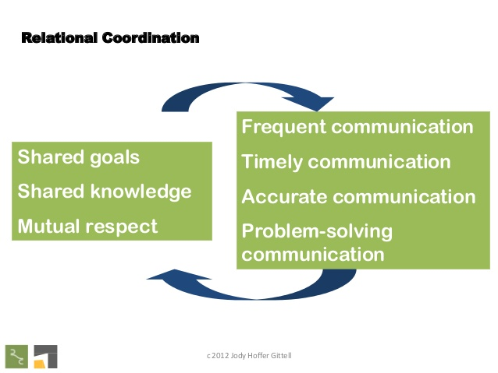
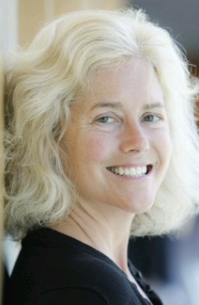


Relational Coordination
Framework for building stronger teams
Dr. Jody Hoffer Gittell

Slide 32
Relational Coordination:
Organizational Theory
Role A
The stronger the “RC” between critical roles, the more successful the organization tends to be in executing its core processes
Role F
Role B
Role E
Core Process
Role D
Role C

Slide 33
Relational Coordination:
7 Core Dimensions
Shared Knowledge
Shared Goals
Mutual Respect
Communication
Frequent
Timely
Accurate
Problem-solving
Adapted from: http://rcrc.brandeis.edu/about-rc/what%20is%20RC.html

Slide 34
Relational Coordination:
When It Matters
Task Interdependence
Time Constraint
Uncertainty

Slide 35
Relational Coordination:
Improvement Framework
Step I: Identify core process
Step II: Map out critical roles
Step III: Survey to assess RC between roles
Step IV: Identify RC strengths/weaknesses
Step V: Design/implement interventions to improve RC weaknesses
Step VI: Re-assess outcomes

Slide 36
Relational Coordination: Matrix
Relational Coordination
Shared Goals
Shared Knowledge
Mutual Respect
Communication: Frequent
Communication: Accurate
Communication: Timely
Communication: Problem-Solving
Pt Care Technicians
Physicians
Nurses
Patient/Family
Social Workers
Case Managers
Physical Therapists

Slide 37
BIDMC RC Survey Results:
Key Findings Summary
Although frequency of communication is a strength, the quality (timeliness, accuracy) is not
Shared knowledge of each others’ roles is a weakness
Patient care technicians share weak RC with other roles
Social workers share high RC with other roles
Although mutual respect and shared goals aren’t weaknesses, they are not strengths, either

Slide 38
Presentation Outline
Background
  Overview of BIDMC, Past Improvement Work
Structural Intervention: FIRM (Fully Integrated Regionalized Micro-teams)
Functional intervention: M.A.P.
Outcomes
Teamwork improvement model:
  Relational coordination
Lessons Learned

Slide 39
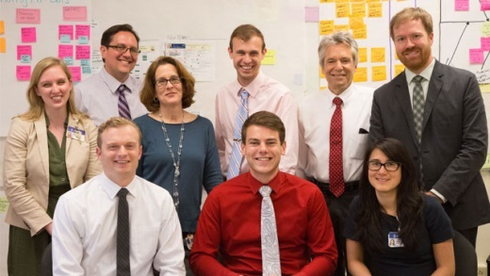
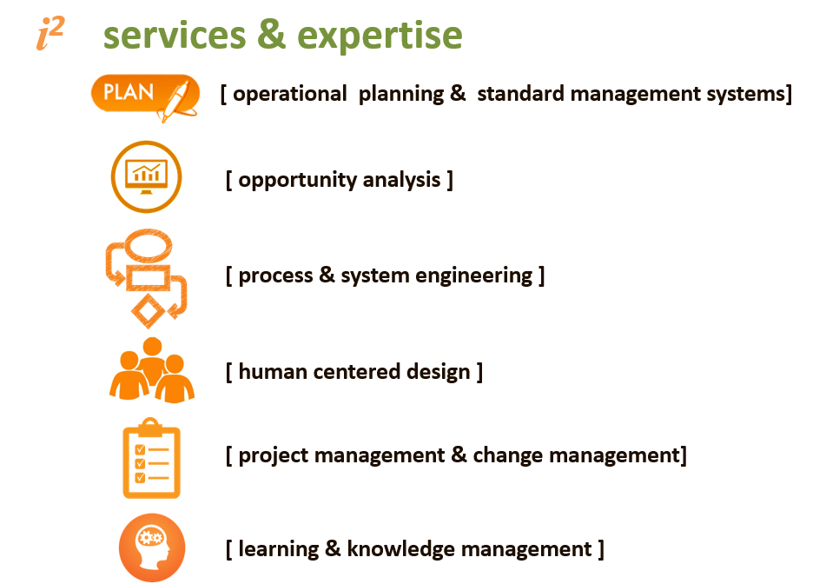
Lessons Learned
Importance of:
  Direct involvement by key leadership (Medical Directors, Nurse Directors, & Chief Resident)
  Expert, embedded, improvement coaching and facilitation (Office of Improvement & Innovation – i²)

Slide 40
Lessons Learned
Assembling a team (through structural changes alone) is not enough
We need to understand each other’s roles in order to communicate the right information at the right time
Although improved teamwork can be felt at the provider level, there is more work to be done in order for the patient experience to improve

Slide 41
Thank You.
Contact Info:
  Dr. Julius Yang, jyang@bidmc.harvard.edu
  Ali Wang, aswang@bidmc.harvard.edu
  Sandra Sanchez, slsanche@bidmc.harvard.edu

